Slide 1
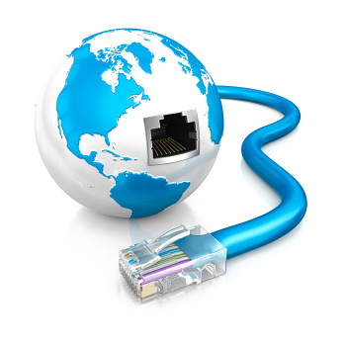
Internet Explained
SoftUni Team
Technical Trainers
Software University
https://softuni.bg

Slide 2
Have a Question?
sli.do
#csharp-web

Slide 3
Table of Content
Introduction to Internet
How does the Internet work?
Packets – Sending and Receiving Data
Internet Protocol
Reliability and TCP
The OSI Model
Network Hardware
The Future of the Internet

Slide 4

Introduction to Internet
An Introduction to the Internet

Slide 5
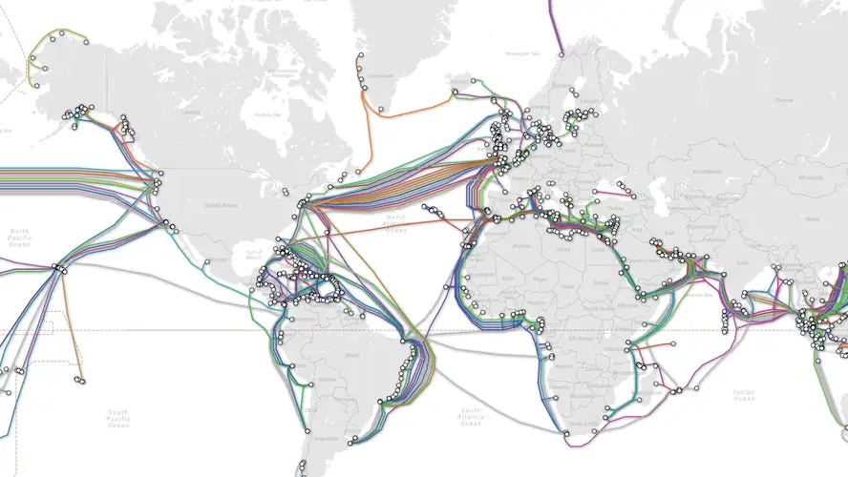
What is the Internet?
Vast network that connects billions of devices together all over the globe
Through fiber optics, copper, satellites or cell phone network
We get indirectly connected though ISPs (Internet Service Providers)

Slide 6
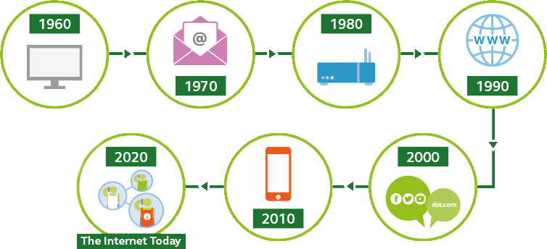
History – Overview
Begins with the development of electronic computers in the 1950s
Packet switching networks were developed in the late 1960
The internet protocol was developed in the 1970s
In the 1980s at CERN Tim Berners-Lee created the World Wide Web – the first website, linking hypertext documents into an information system, accessible from any node on the network

Slide 7
What is a Network?
Network == a group of two or more devices that can communicate
It is comprised of a number of different computer systems connected by physical and/or wireless connections
The scale can range from a single PC sharing out basic peripherals to massive data centers located around the world, to the Internet itself

Slide 8

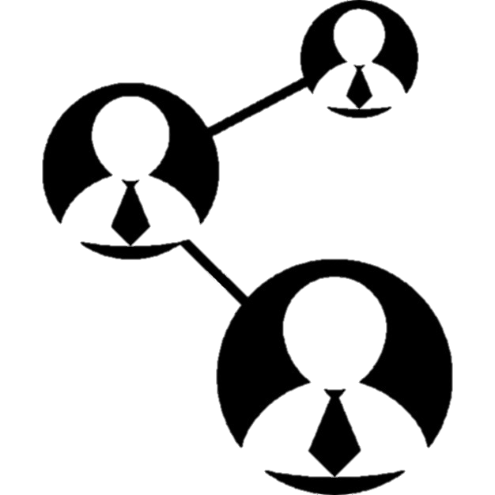

Networks and Internet
The Internet is made of hundreds of thousands of networks and billions of computers and devices connected physically
These different systems connect to each other, communicate with each other and work together because of standards for how data is sent

Slide 9

How Does the Internet Work?

Slide 10

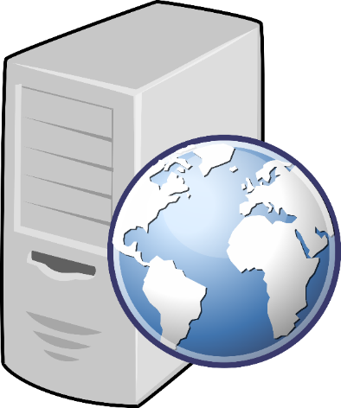

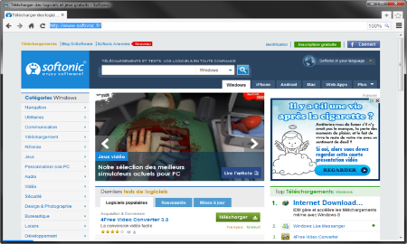





Web Server Work Model
Web Client
Web Server
Technology
Request
Response
Web Resources
Database
HTML, PDF, JPG…

Slide 11

Important Definitions
To understand how the Internet works, first we need to get acquainted with a few definitions
What is?
Server and Client
Network Protocol
Packets
TCP vs UDP

Slide 12

Servers and Clients
All of the machines on the Internet are either servers or clients
Servers are the machines that provide services to other machines
Clients are the machines that are used to connect to those services

Slide 13

Network Protocol
Network Protocol == a set of rules and standards, that allow communication between network devices
Network protocols include mechanisms for devices to identify and make connections with each other
Examples for standard network protocols
TCP, QUIC, UDP, IP, ARP
HTTP, FTP, TFTP, SMTP, SSH

Slide 14
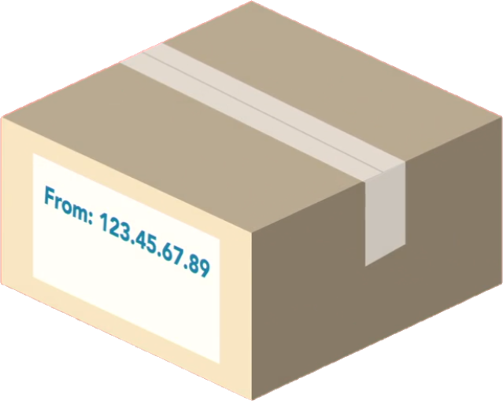
Packets
Sending and Receiving Data

Slide 15
Packets
Everything that is created on a computer is translated into digital data using bits
Bits need to have a way to be transmitted over the Internet
Every message, file or stream of data is broken down into small chunks, called packets
When packets are sent on the Internet, they usually travel the network together
But they might have to take a different route to get to the destination

Slide 16
Packets
Each packet contains some important information inside of it, called a header
Where it came from
Where it is going
How long it is
This is how the packet is known to be complete
All the packets in the message are the same size
How many packets there are in the overall message

Slide 17
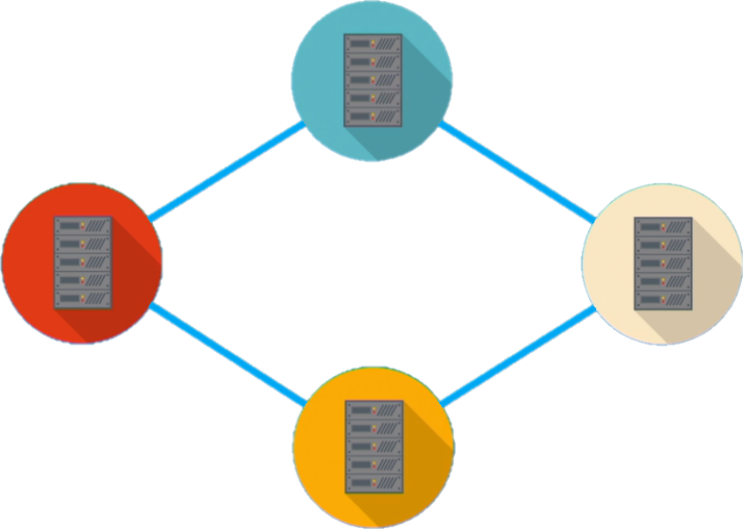
Traveling of the Packets in the Network

Slide 18
Internet Protocol
216.58.214.46
www.google.com
IPv4, IPv6 and DNS

Slide 19


Internet Protocol
One of the most important protocols used in Internet communication is the Internet Protocol (IP)
All the devices on the Internet have addresses
They are called IP Addresses
The IP address is unique to each computer or a device at the edge of the network
IP Address:
192.168.10.5
IP Address:
192.168.0.1

Slide 20
IP Address
An IP Address has many parts, organized in a hierarchy
This version of IP Addressing is called IPv4
Provides more than 4 billion 32-bits unique addresses
Subnetworks
192.168.14.120
Device address

Slide 21
IPv4
IPv4 == sequence of 4 three-digit numbers, separated by a period
Each number can be a number from 0 to 255
IPv4 is not enough for all network devices connected to the internet
In 1995, a new version of the Internet Protocol was created, it's called IPv6

Slide 22
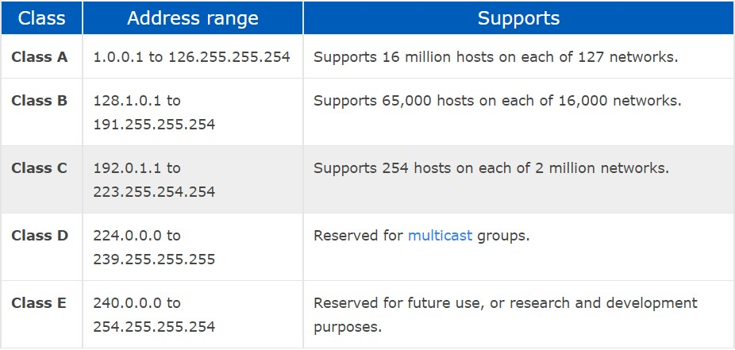
IP Address Classes

Slide 23
What Is CIDR (Classless Inter-Domain Routing)
Classless Inter-Domain Routing == IP addressing scheme that improves the allocation of IP addresses
It replaces the old system based on classes A, B and C
This scheme also helped greatly extend the life of IPv4 as well as slow the growth of routing tables

Slide 24
IPv4 Private Address Space and Filtering
CIDR | IP address range | Class
10.0.0.0/8 | 10.0.0.0 – 10.255.255.255 | A
172.16.0.0/12 | 172.16.0.0 – 172.31.255.255 | B
192.168.0.0/16 | 192.168.0.0 – 192.168.255.255 | C

Slide 25
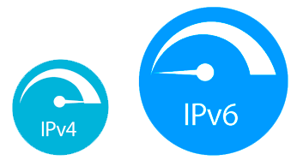
IPv6
IPv6 uses 128 bits – 340 undecillion unique addresses
That's more than the atoms on the surface of the Earth
These 128 bits are organized into eight 16-bit sections
Each 16-bit block is converted to hexadecimal and it's separated with a colon
Full IPV6 address
3FFE:F200:0234:AB00:0123:4567:8901:ABCD
The leading zeros in IPv6 can usually be left out (not recommended)

Slide 26
What is a DNS?
www.softuni.bg
Domain name
The domain name is a human way to access IP addresses for devices and websites around the world
It is a sequence of phrases that map to a giant Internet-wide database of IP addresses
When a domain name is entered in the browser, a request is made to something called a DNS (Domain Name Server)
This server holds a cache of tons of domain names, and their matching IP addresses

Slide 27



DNS Example
request
IP Address | Domains
216.58.214.46 | google.com
217.174.159.195 | softuni.bg
https://softuni.bg
(217.174.159.195)
response

Slide 28
Reliability and TCP
TCP

Slide 29
Reliability
When packets are transmitted from one location to another, they can take different paths
When they get to the destination, they are unorganized and sometimes not complete
So the message needs to be audited and reviewed in order to put it together in the right way
The Transmission Control Protocol or TCP does exactly that

Slide 30
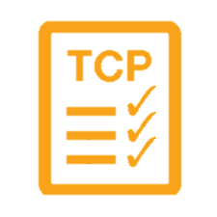
Transmission Control Protocol - TCP
TCP uses a process, where it looks at all the packets in a message and checks them
Using the header information in each packet, it knows
How many there are
How large they should be
In which order the packets should be in
Using this checklist, it is able to rearrange the packets

Slide 31


Transmission Control Protocol - TCP
If it finds that a packet doesn't match the expected characteristic, it is discarded
TCP verifies that all the packets are
In the right order
Free of any issues
After that it certifies the data and the packets are merged together to recreate the original file that was on the sender's device

Slide 32

User Datagram Protocol
UDP does not establish a session and it does not guarantee data delivery
It is known as the "fire-and-forget" protocol
It sends data and it doesn't really care if the data is received at the other end
Missing packets..
I don't care..
UDP

Slide 33
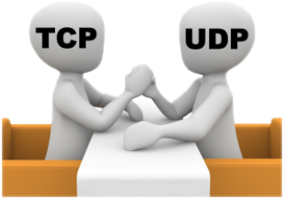
TCP vs UDP
TCP places reliability in a higher priority than speed or latency
For instances where reliability isn't as important, but speed is, UDP is used
UDP doesn't do excessive reliability checks, but it can send information at a faster rate
TCP is the foundation of how a majority of data is transmitted over networks

Slide 34
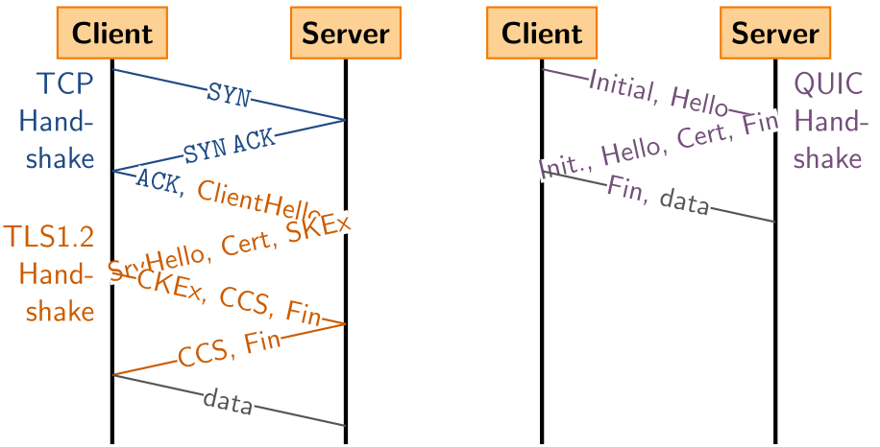
QUIC Protocol
QUIC == new transport protocol designed for mobile-heavy Internet usage
Uses UDP as its basis, not TCP
Packets are encrypted individually
Exchange of supported protocols is a part of the initial handshake process

Slide 35
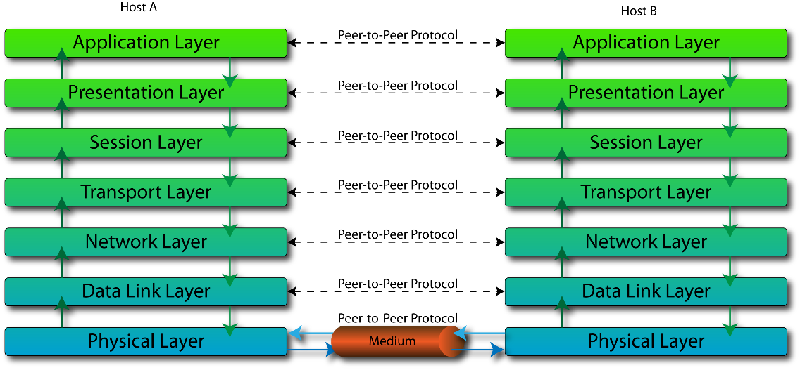
The OSI Model

Slide 36
What is the OSI Model?
OSI model stands for Open System Interconnect
It consists of 7 layers
Each layer serves the layer above it and in return, is served by the layer below it
Understanding each layer of the model helps us with
Troubleshooting
Communicating better with technical and non- technical individuals about any system

Slide 37
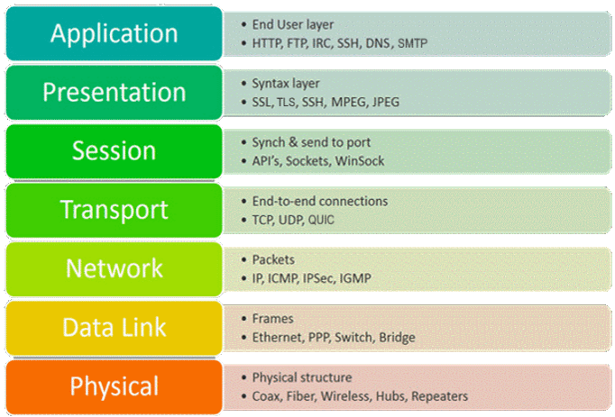
OSI Layers

Slide 38
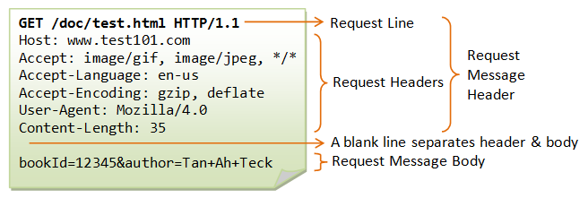
Application Layer – 7
Only layer that directly interacts with the user
Software applications, e.g., web browsers and e-mail clients, rely directly on its protocols
Protocol examples
DNS, FTP, HTTP, SMTP, POP3, IMAP
Most important layer for software engineers

Slide 39
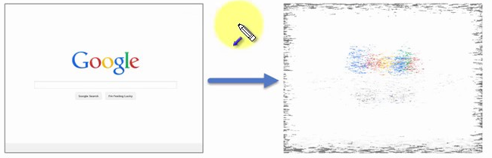
Presentation Layer – 6
This layer is a part of the operating system (OS)
Converts incoming and outgoing data from one presentation format to another
Responsible for translation, encryption, and compression of data
Protocol examples
SSL, TSL

Slide 40
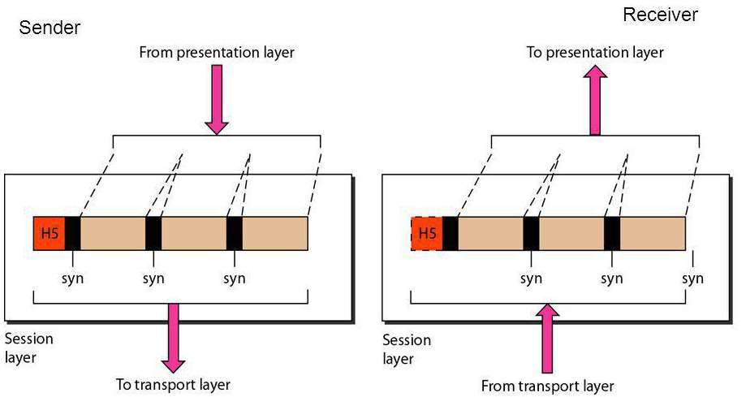
Session Layer – 5
Controls the dialogues (connections) between computers
Establishes, manages and terminates connections between the local and remote application
Its services include authentication and reconnection after an interruption
Protocol examples
RPC, PPTP

Slide 41
Transport Layer – 4
Responsible for end-to-end communication over a network
Transfers data, splitting it into pieces (segments)
Provides logical communication between application processes
Responsible for the management of error correction, providing quality and reliability to the end user
Important concept for web devs – port number
Protocol examples – TCP, QUIC, UDP

Slide 42
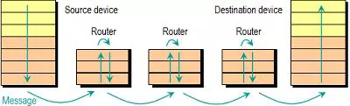
Network Layer – 3
Transfers packets from one node to another
Responds to service requests from the transport layer and issues service requests to the data link layer
Protocol examples
IP, IPv6, IPSec, ICMP, IGMP
Important concept for web devs – IP address

Slide 43
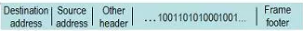
Data Link Layer – 2
Provides node-to-node data transfer
The data transferred is split into packets – frames
It detects and possibly corrects errors that may occur in the physical layer
Divides into two sublayers
Medium Access Control (MAC) layer – controlling how devices in a network gain access to a medium and permission to transmit data
Logical Link Control (LLC) layer – identifying and encapsulating network layer protocols, controls error checking and frame synchronization
Example protocols – ATM, Ethernet, MAC

Slide 44
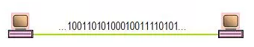
Physical Layer – 1
It is responsible for the physical connection between two or more parties
Converts the binary from the upper layers into signals, transmits them over local media (electrical, light, or radio signals)
Examples
Ethernet
USB
Bluetooth
802.11a/b/g/n

Slide 45
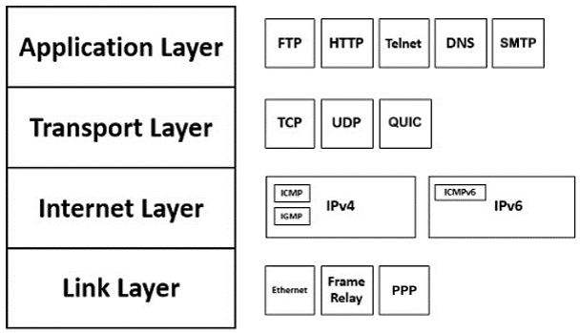
TCP/IP Protocol Suite
The 7-layer OSI model is too complicated, it's designed for network engineers and communication experts
In software development a simplified networking models exists, called the "The TCP/IP protocol suite" with 4 layers
Link – combines physical media and data link protocols
Internet – transmits packets between 2 hosts
Transport – provides communication between 2 endpoints
Application – defines the way apps talk to each other

Slide 46
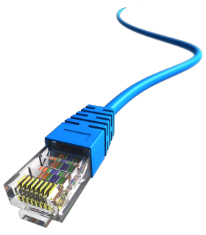
Network Hardware
Basic Hardware Components

Slide 47
Network Hardware
Basic Hardware Components
Cables
Routers
Repeaters, Hubs and Switches
Bridges
Gateways
Network Interface Cards

Slide 48
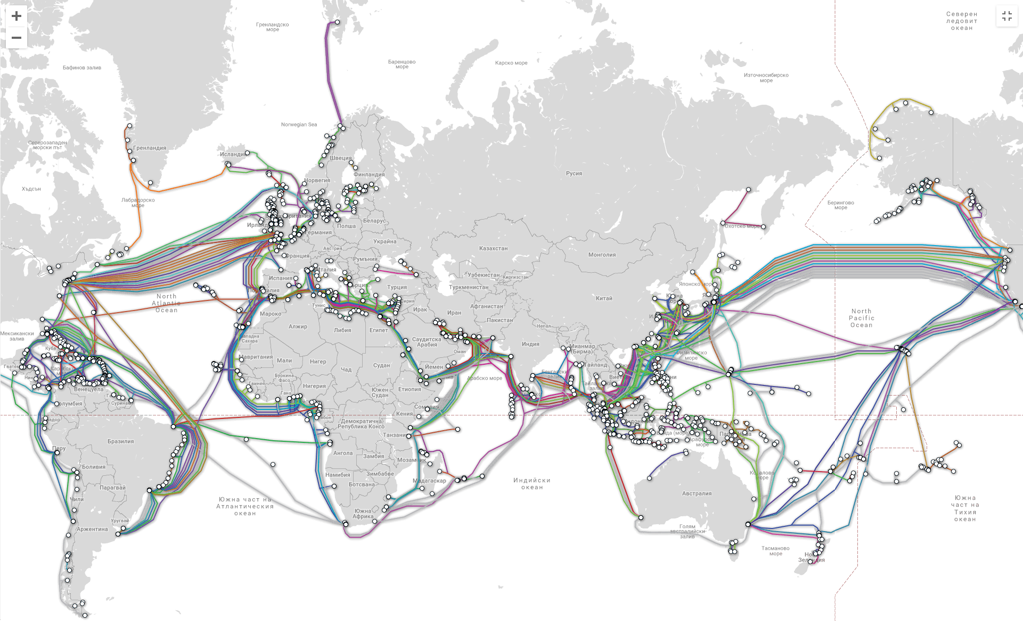
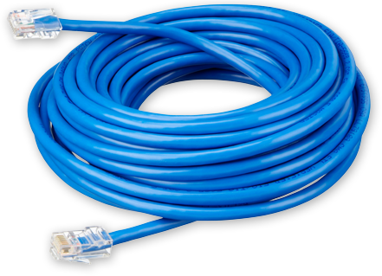
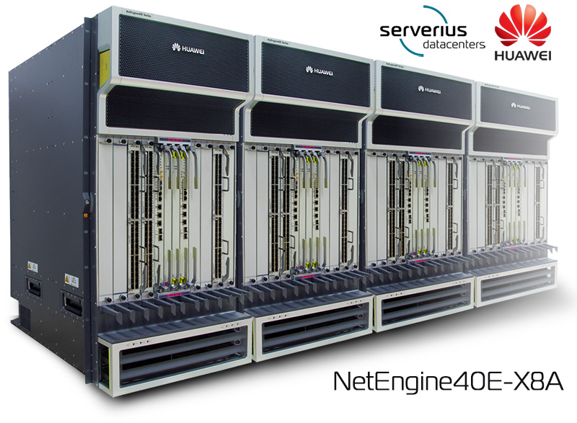
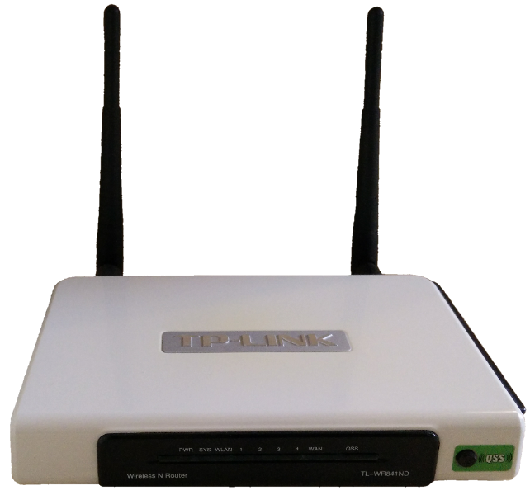
Cables and Routers
Network cables – the transmission media to transfer data from one device to another
Router – connecting device that transfers data packets between different computer networks (operates on level 3 of OSI)

Slide 49
Repeaters, Hubs and Switches
Repeaters, hubs and switches connect network devices together so that they can function as a single segment
Repeater – receives a signal and regenerates it before re-transmitting, so that it can travel longer distances
Hub – multiport repeater (operates on level 1 of the OSI model)
Switch – receives data from a port, uses packet switching to resolve the destination device and forwards the data to the particular destination (operates on level 2 of the OSI model)

Slide 50
Bridges and Gateways
Bridge
Connects two separate but similar Ethernet network segments
Forwards packets from the source network to the destined network (operates on level 2 of OSI)
Gateway
Connects networks that work upon different protocols
The entry and the exit point of a network (controls the access to other networks)
Level 4, 5, 6 or 7 of the OSI model (same as Firewalls)

Slide 51
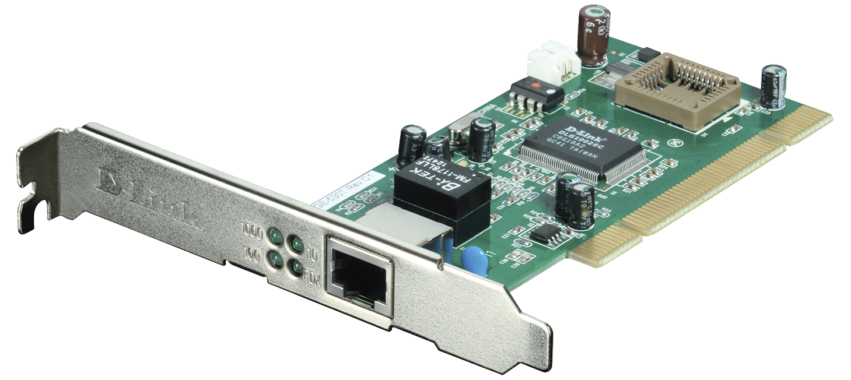
Network Interface Cards – NIC
NIC – a computer component that connects it to the network
There are two types of network cards
Internal
External

Slide 52
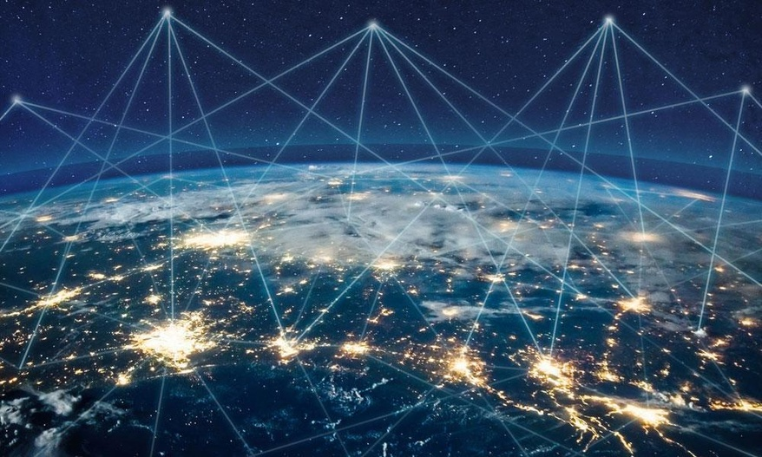
The Future of the Internet

Slide 53
The Future of the Internet
A typical modern home consists of: PC, Laptop, Tablet, Phones, TV, Security Camera, Air Conditioner, Smart Watch, Printer, Music Player, Light, etc.
The "Internet of Things" will expand
Healthcare, agriculture, wearables, manufacturing
Smart homes, cars and cities (pollution, parking, energy)
In 2030 there will be 50 billion devices connected to the Internet of Things

Slide 54

Summary
…
…
…
Internet and Definitions of Internet
Sending and Receiving Data
OSI model
Layers
Network Hardware
The Future of the Internet

Slide 55









Questions?

Slide 56










SoftUni Diamond Partners

Slide 57
Trainings @ Software University (SoftUni)
Software University – High-Quality Education, Profession and Job for Software Developers
softuni.bg, about.softuni.bg
Software University Foundation
softuni.foundation
Software University @ Facebook
facebook.com/SoftwareUniversity
Notes:
57

Slide 58

License
This course (slides, examples, demos, exercises, homework, documents, videos and other assets) is copyrighted content
Unauthorized copy, reproduction or use is illegal
© SoftUni – https://about.softuni.bg/
© Software University – https://softuni.bg
Notes:
58

